Slide 1
CSC 394 - Team 5 - Week 1
Nick Bashor
Patrick Grzegorczyk
Wesam Jabali
Joey Navarro
Kevin Sass
Luigi Yebra

Slide 2
Requirements
Users
Maintain list of users
Allow registration / deletion
Allow profile editing
Role differentiation (student vs. faculty)
Restrict views based on privileges
Faculty
Create classes
Create teams / add members
Add content
Add grades
Security
Password setting / changing
Login / logout features
User authentication
Communication
Class discussion boards
Content-based discussion boards

Slide 3
Architecture
Frontend: Vue.JS (Vue 3)
Design library: Vuetify
Backend: Node with Express.JS or NestJS
Database management: PostgreSQL
Query builder: Knex.JS

Slide 4
Database Design
User
Name
Role (student/faculty)
Contact info
...
Team
Name
...
Class
Title
Number
Meeting time(s)
...
User | Team
User ID | Team ID
...
User | Class
User ID | Class ID
...
All table entries are automatically assigned
unique IDs and timestamps.

Slide 5
Database Design (cont’d)
Content
Class ID
Title
Description
File URL (optional)
Is graded? (True/False)
Grade (optional)
...
Discussion Post
Content ID (optional)
Class ID (optional)
Parent ID (optional)
User ID
Title
Post content
...
If Content ID is non-null, the discussion post belongs to a content item
If Class ID is non-null, the post belongs to a general class discussion
If Parent ID is non-null, the post is a response to another parent (root) post
All table entries are automatically assigned
unique IDs and timestamps.

Slide 6
Hardware / Software
Frontend Host: Netlify
Backend Host: Heroku
Database: Amazon AWS via Heroku
Version control: Git (via GitHub)

Slide 7
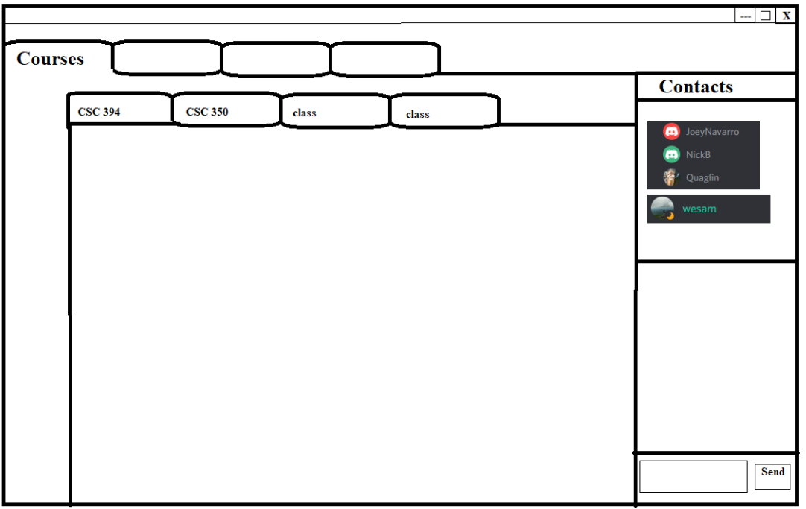
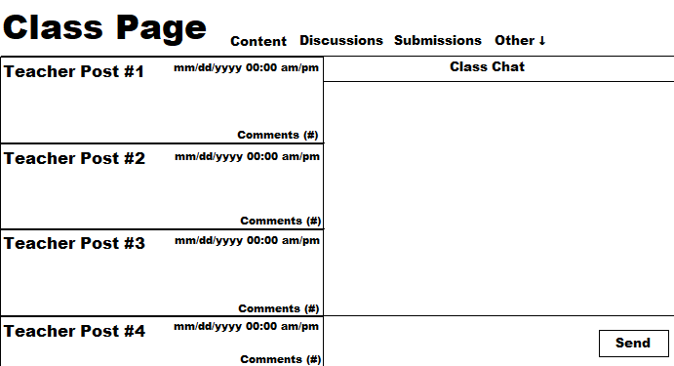
GUI Design

Slide 8
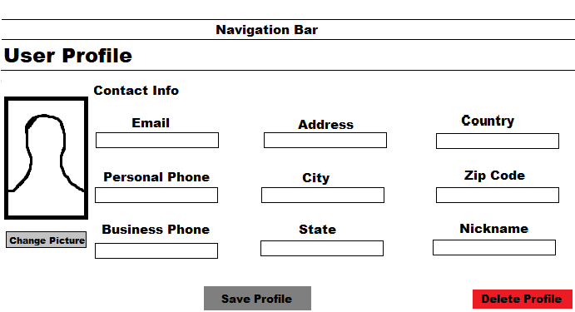
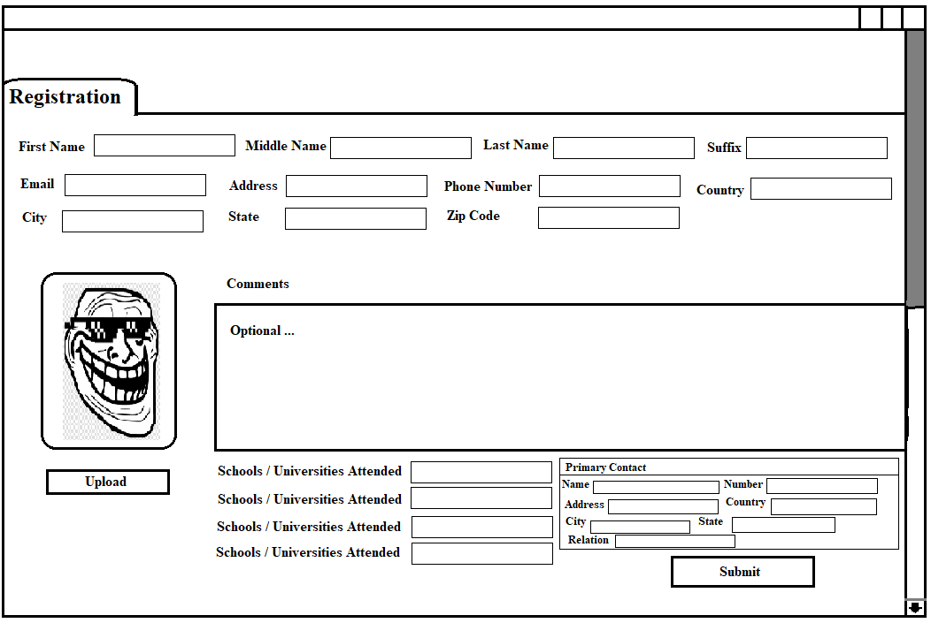
GUI Design (cont’d)

Slide 9
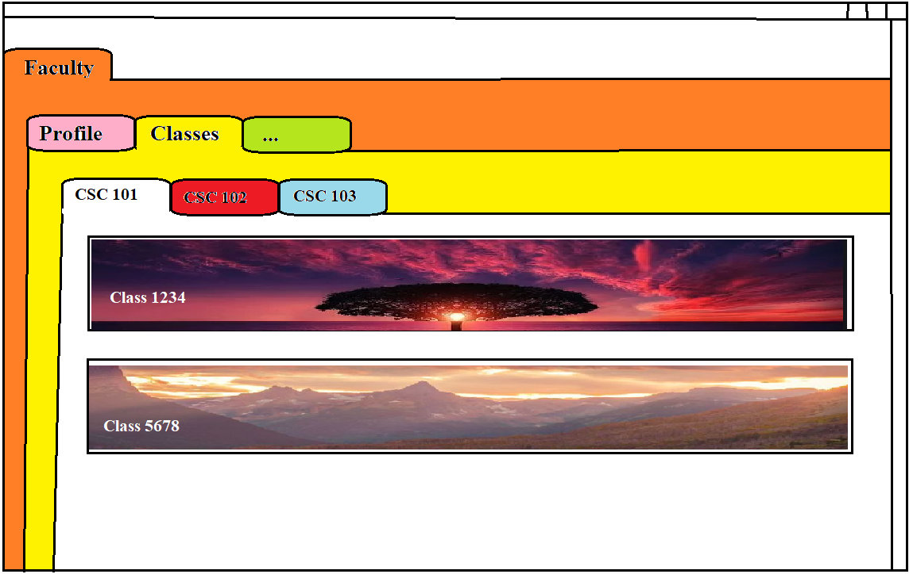
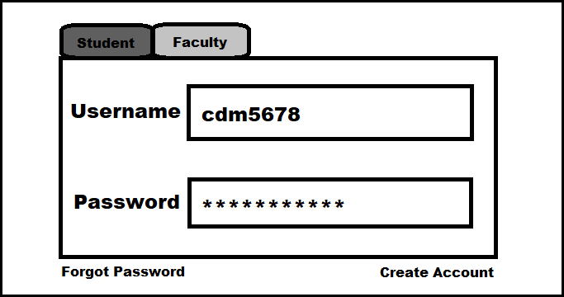
GUI Design (cont’d)

Slide 10
Team Member Roles
Roles:
Joey/Wesam: Build DB
Backend Developers: Joey/Wesam/Kevin
Frontend Developers: Patrick/Nick/Luigi
Visual: Nick
Logic: Patrick/Luigi
Quality Assurance:
Frontend: Wesam
Backend: Patrick

